Slide 1
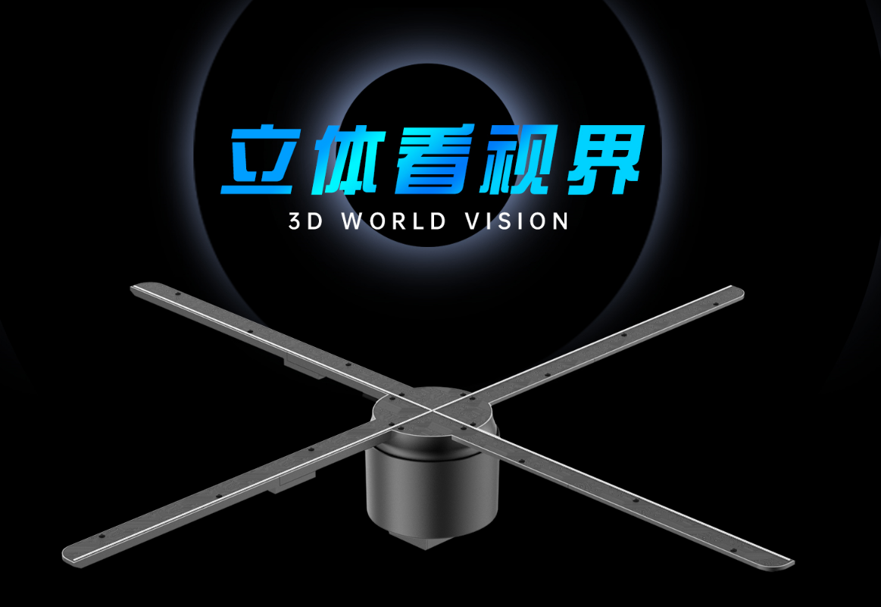
3D Holographic Solution Provider

Slide 2
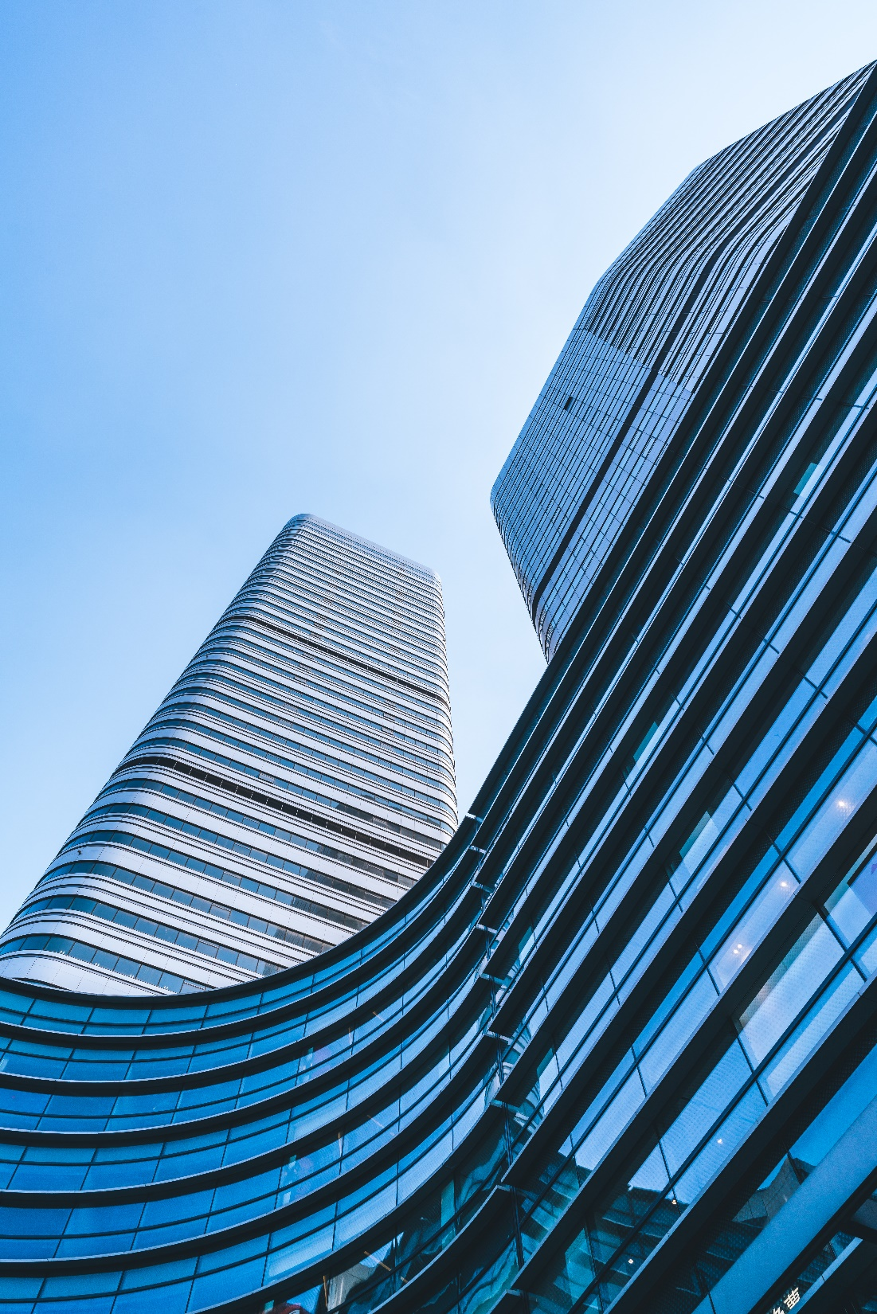
CONTENTS
1
About Us
2
Product Introduction
3
Application

Slide 3
PART 1
About Us

Slide 4
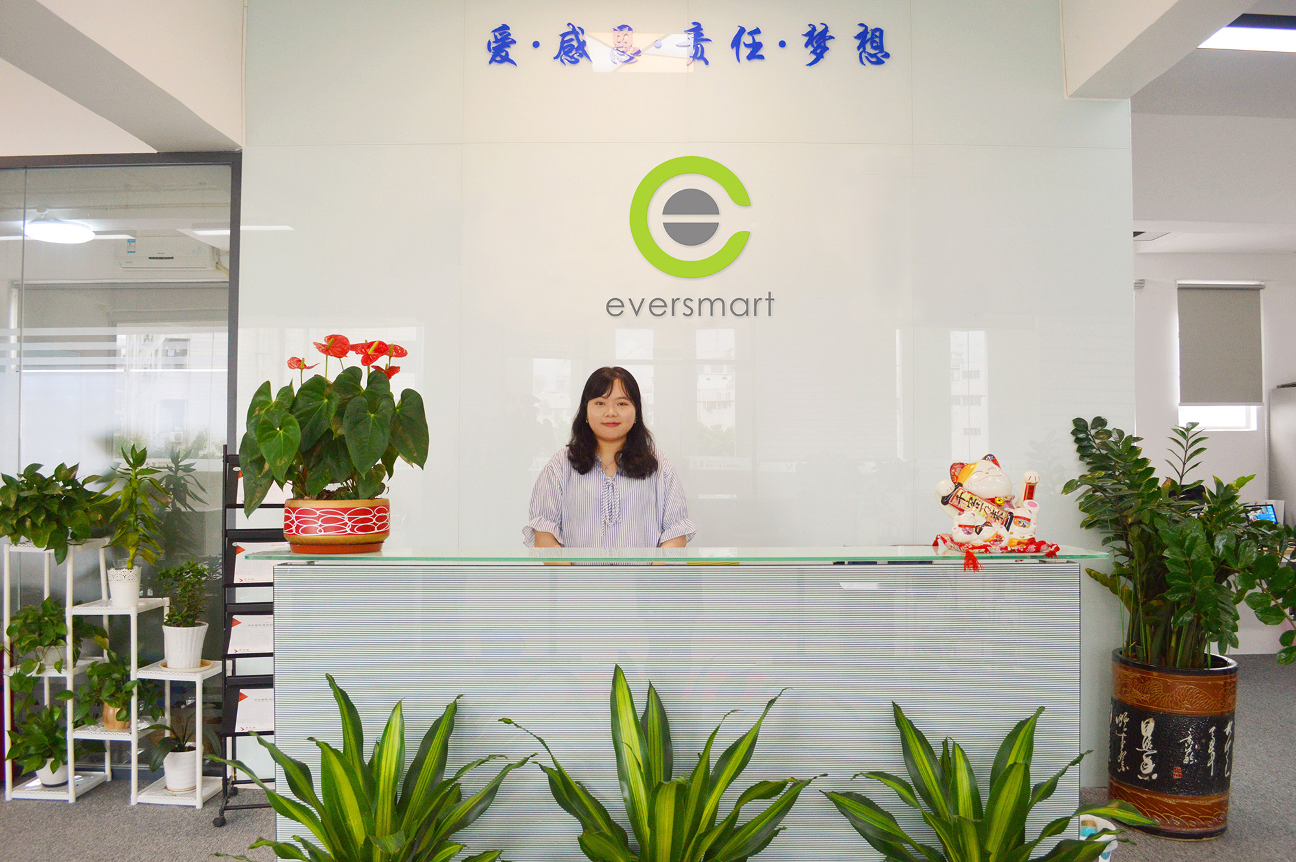
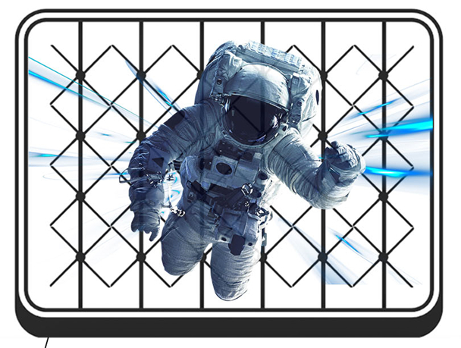
3D Holographic Machine
ISO9001 factory
Leading R&D manufacturer of 3D industry, with independent patents
Rich experiences in over 20,000 successful cases
CE ROHS FCC certified
Partner with big brands such as VOLVO, BMW, KFC, LI-NING, Huawei, etc

Slide 5
PART 2
Products
Introduction

Slide 6
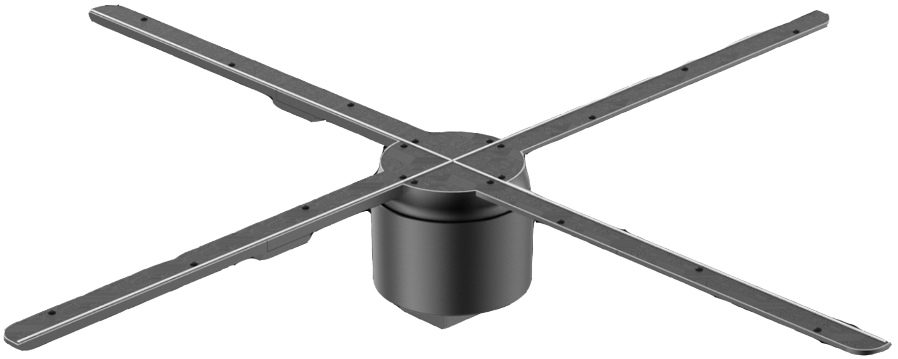
What is 3D holographic advertising machine
A new type of advertising media equipment.
It uses LED light bar rotating display technology and the principle of human eye retention to form graphic, animation and video.
It has no borders and no background, which makes people feel that images are suspended in the air.

Slide 7
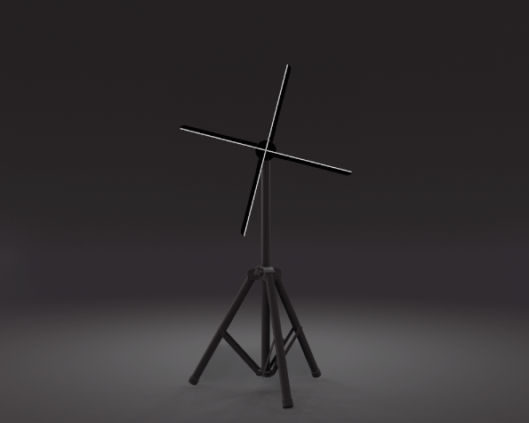
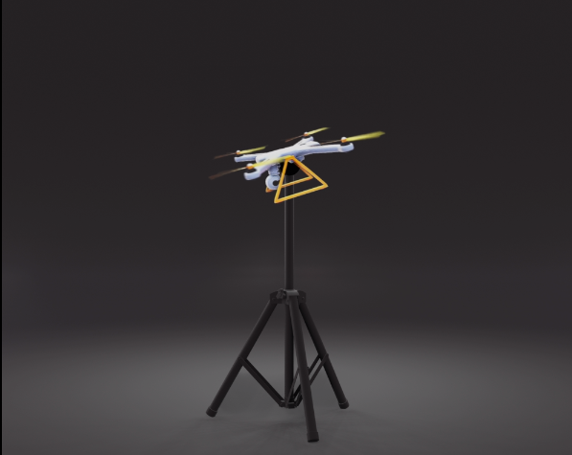
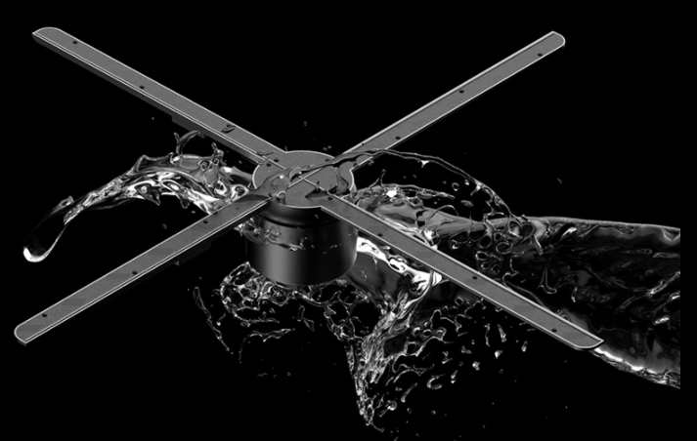
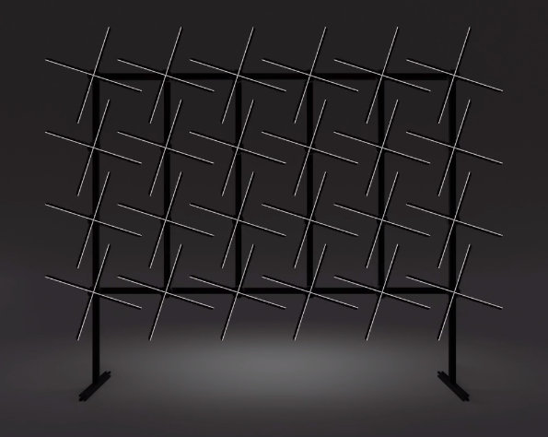
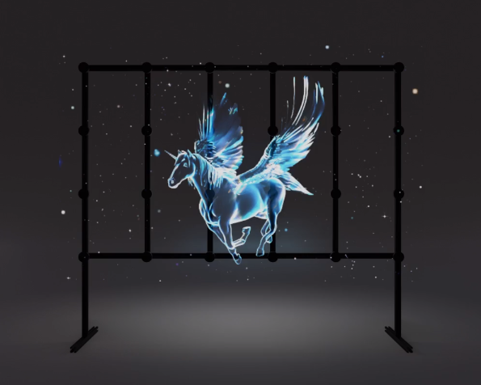

Slide 8
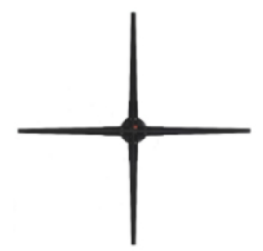
Product Features
Real naked eye hologram
Efficient management
No boarder and background
LED bar rotating display
Mini LED&Micro LED chip to provide HD image
Plug and play
Cloud wifi/Mobile APP control
Windows/IOS/Android compatible
One user account controls mutiple devices
Cost effective
Multiple options
Zero structural cost
Less power consumption
Long service life
Low installation and maintenance cost
Size: 32cm/100cm etc.
Waterproof
Customized accessory

Slide 9
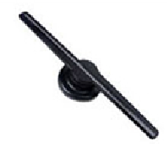
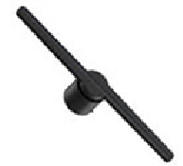
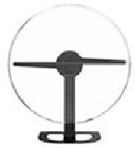
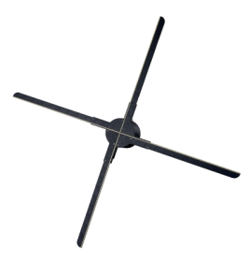
Product Parameters
Model NO. | E42S | E42A | E32C | E45C | EX50 | EX56 | EG65 | EG80 | EP80
Resolution | 450*224 | 450*384 | 1400*224 | 1400*512 | 512*512 | 640*640 | 720*720 | 1280*1280 | 1280*1280
Size(cm) | 43*43*3.5 | 43*43*4 | 38*34*12 | 38*34*5.5 | 46*46*5.5 | 56*56*5.5 | 65*65*5.5 | 77*77*5.5 | 77*77*5.5
LED QTY | 224pcs | 384pcs | 224pcs | 512pcs | 512pcs | 640pcs | 720pcs | 1280pcs | 1280pcs
Output Voltage | 12V 3A | 12V 3A | 12V 3A | 18V 3A | 24V 3A | 24V 3A | 24V 3A | 24V 5A | 24V 5A
Rated Power | 20W | 36W | 15W | 35W | 45W |  |  | 60W | 60W
Memory | 16G |  |  |  | 8G+8G(built-in memory)
Brightness | low | high | medium | high | super high | super high | super high | super high | super high
Upload Method | Memory card | Memory card, APP, PC, Cloud | Memory card, APP | Memory card, APP | Memory card, APP, PC, Cloud

Slide 10
Product Parameters
Model NO. | E42S | E42A | E32C | E45C | EX50 | EX56 | EG65 | EG80 | EP80
Wired Control | × | × | × | × | √ | √ | √ | √ | √
Online Upgrade | × | × | × | × | √ | √ | √ | √ | √
Music Function | × | √ | × | × | √ | √ | √ | √ | √
Group Display | × | √ | × | × | × | √ | √ | √ | √
Human-Computer | × | × | × | × | × | × | × | × | √
Real-Time | × | × | × | × | × | × | × | × | √
NET Weight | 0.26kg | 0.21kg | 1.26kg | 0.45kg | 0.52kg | 0.65kg | 0.7kg | 0.8kg | 0.8kg

Slide 11
Comparison
3D Holographic Advertising
01
Eye-catching with 3D HD presentation
3D technical industry rapidly grow and is widely used
Long development and life cycle, high profit
Traditional Advertising
Paper leaflets is not interesting and not environmentally-friendly
Screen display is costly and long payback time
Advertising broadcast cycle is too long, visually fatigued
02

Slide 12
Why to choose us
Rich experience with over 20,000 big case
Best pre and after sales service
Strong technical support
Self-designed APP with rich functions
Simple operation
1
6
2
Brushless motor, more durable
Life expectancy increased by 50%
Independent patents
5
3
4
Brighter RGB LED chips
Clearly visible image under outdoor sunlight
More stable chip control
Faster material transfer and firmware update, less heat

Slide 13
Application
PART 3
Widely used in shopping mall, subway, train station, airport, bar, cinema, conference scene, etc.

Slide 14
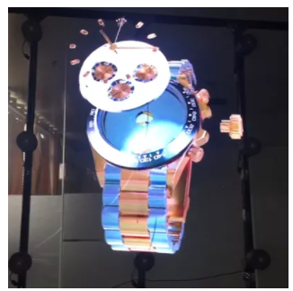
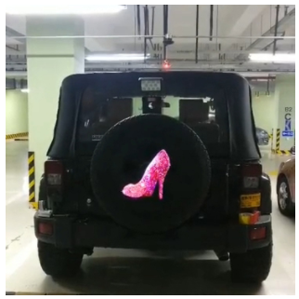
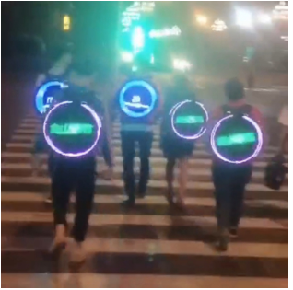
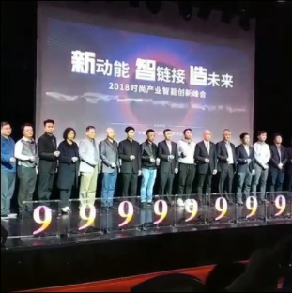
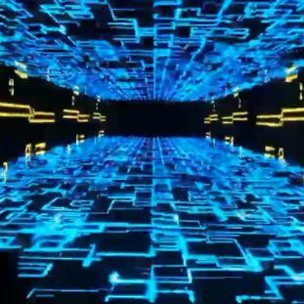
Botanical garden Company decoration Restaurant Product display
Car display Backpack display Ceremony Karaoke

Slide 15
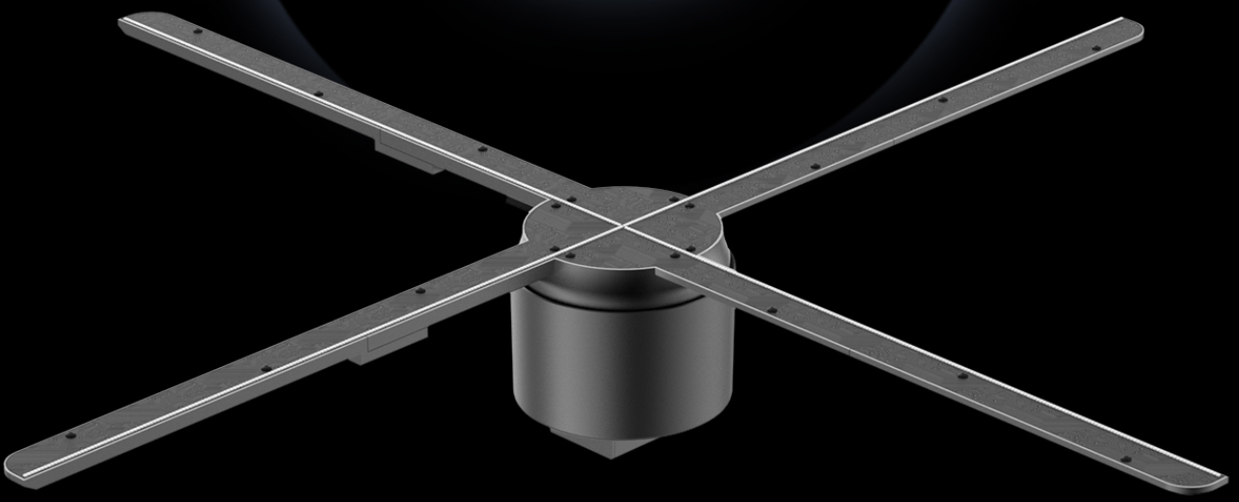
Shenzhen Eversmart Technology Co;LTD
Mobile/Whatsapp: +8613923461129*Wechat: zthgladys*Skype: gladys1226**Email: gladys@eversmart.net.cn
Address: 4th Floor, Sogood Hi-tech Innovation Park, Hangkong Rd, Hangcheng St, Baoan, Shenzhen, China

