Slide 1
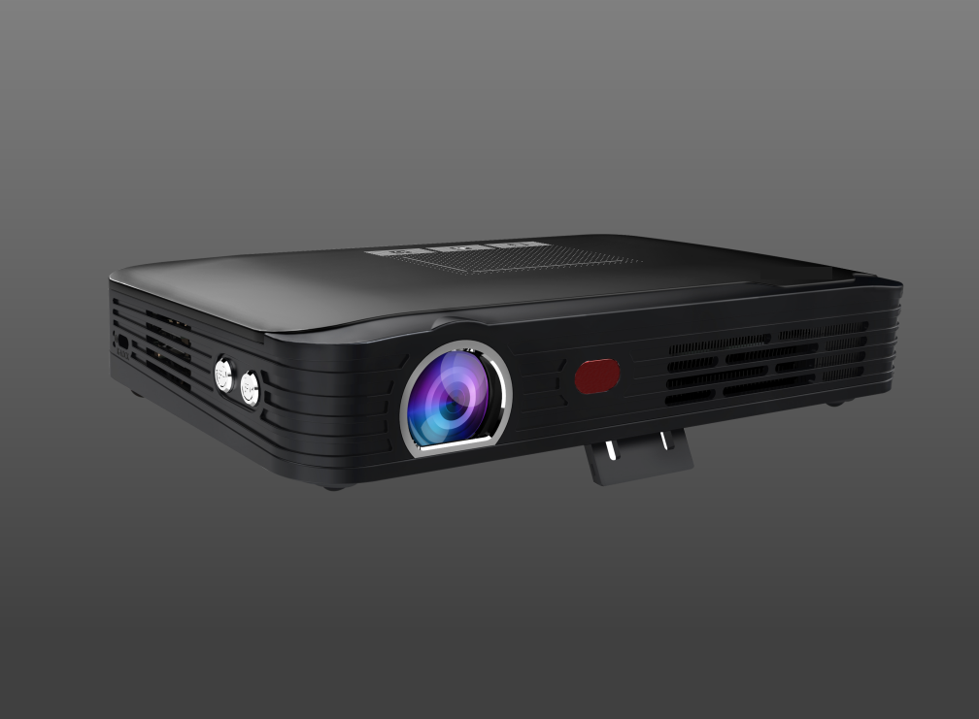
ES-P41
Android 7.1 OS
Built in battery
Auto + Electric focus

Slide 2
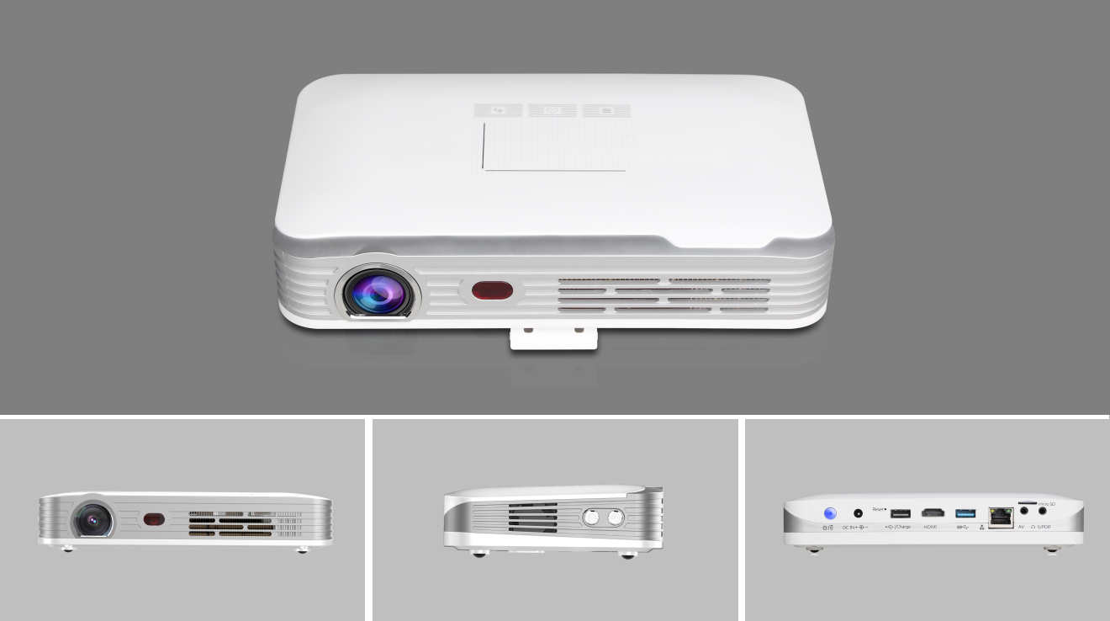

Slide 3
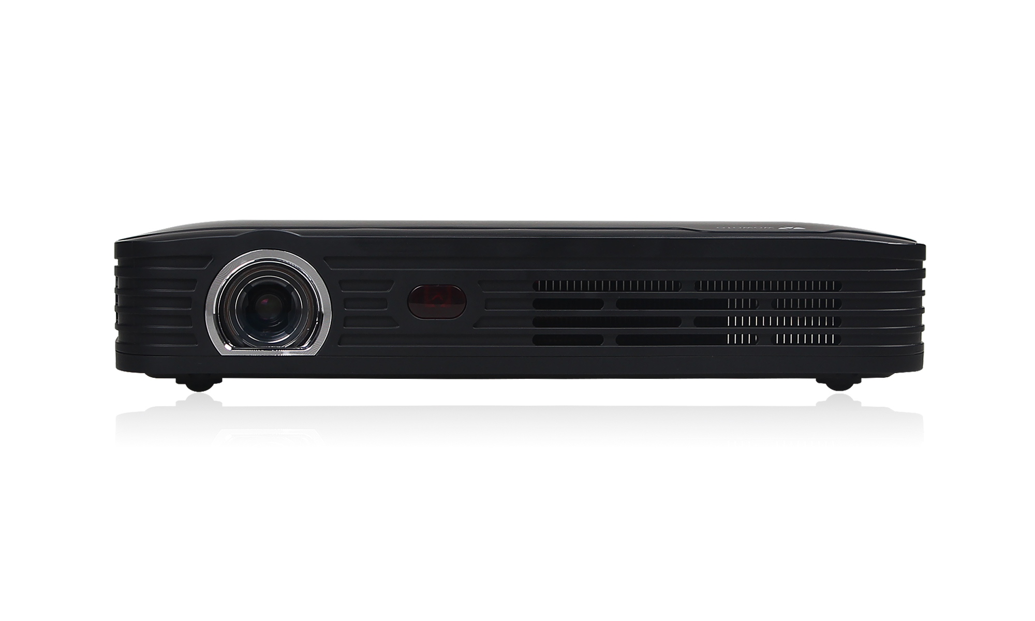
Projector Type
Model
Projection Technogy
Light Source
Colour
Dimension
Brightness
Native Resolution
Light Life
Projection Ratio
Projection Distance
Aspect ratio
Focus Mode
Keystone Correction
System memory
Rom
WLAN
Bluetooth
Power
Product weigh
Android Portable
ES-P41
DLP
LED
Black
198*122*43mm
500ANSI
1280x800
>20000 hours
1.2:1
20-150 inch
16:9
Electric + automatic
Vertical + horizontal correction
2GB
16GB
802.11 a/b/g/n（2.4G+5G dual band）
BT4.0
19V 2.1A
690g
Product Parameters
43mm
198mm

Slide 4
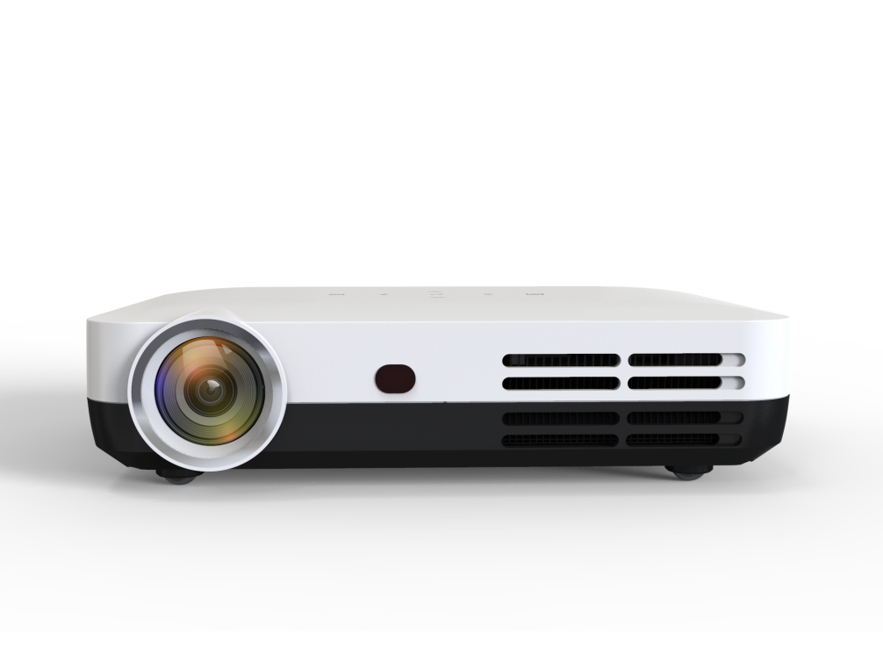
ES-P43
Wireless same screen
4K HD decoding
Four way trapezoidal correction
Home, office, travel

Slide 5
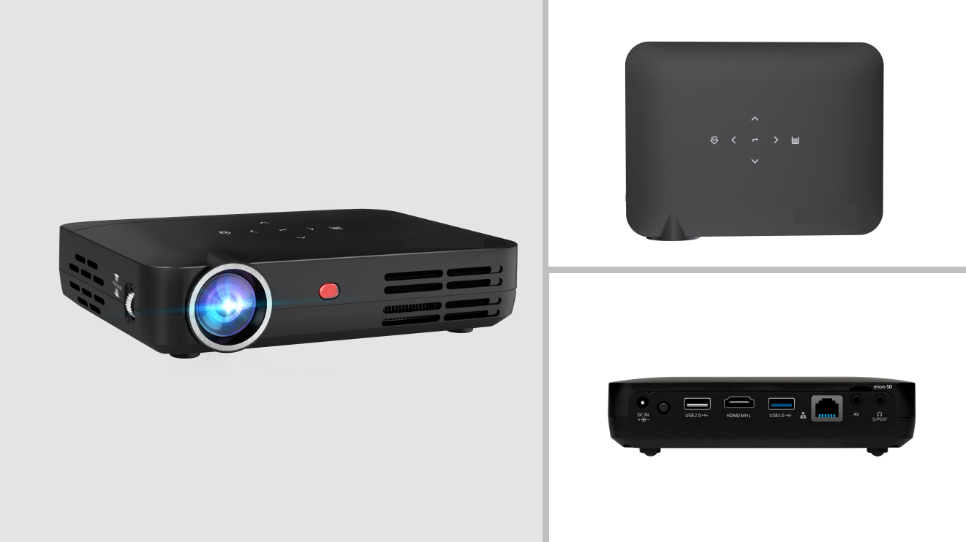

Slide 6
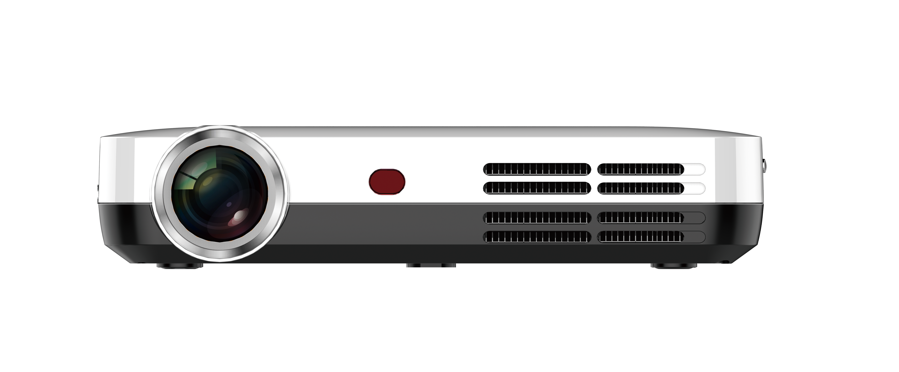
Projector Type
Model
Projection Technogy
Light Source
Colour
Dimension
Brightness
Native Resolution
Light Life
Projection Ratio
Projection Distance
Aspect ratio
Focus Mode
Keystone Correction
System memory
Rom
WLAN
Bluetooth
Power
Product weigh
Android Desktop
ES-P43
DLP
LED
Black / White
159*120*31mm
500ANSI
1280x800
>20000 hours
1.2:1
80-200 inch
16:9
Manual
Four way+automatic vertical
2GB
16GB
802.11 a/b/g/n（2.4G+5G dual band ）
BT4.0
19V 3.42A
1150g
Product Parameters
31mm
159mm

Slide 7
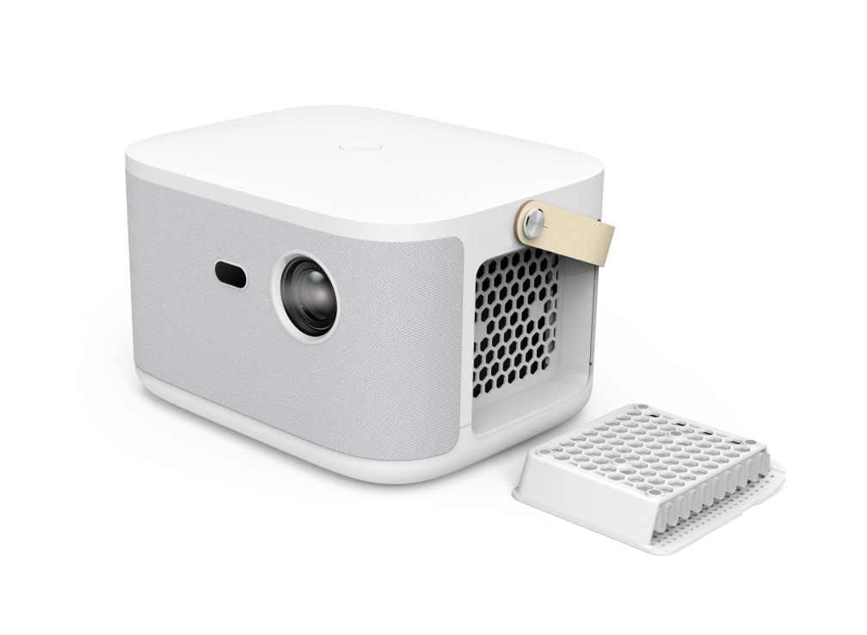
ES-P49
Sealed dust proof storage box
1080P native resolution
Four way trapezoidal correction
Auto Focus

Slide 8
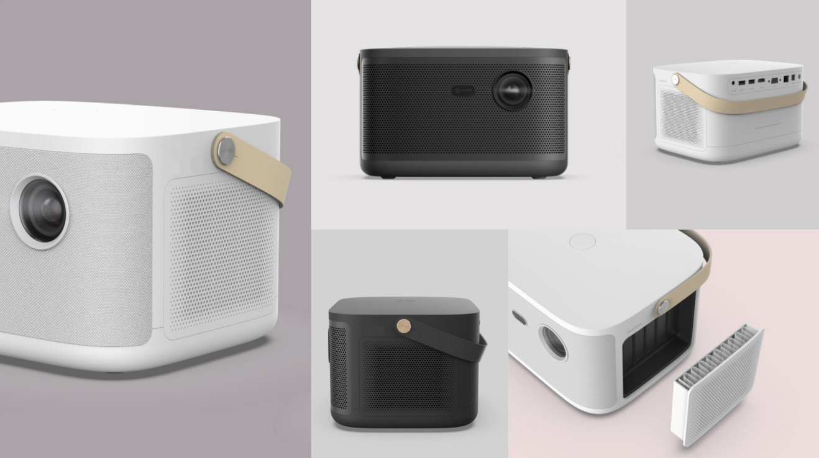

Slide 9
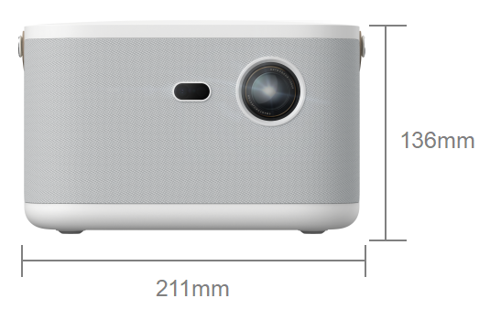
Product Parameters
Projector Type
Model
Projection Technogy
Light Source
Colour
Dimension
Brightness
Native Resolution
Light Life
Projection Ratio
Projection Distance
Aspect ratio
Focus Mode
Keystone Correction
System memory
Rom
WLAN
Bluetooth
Power
Product weigh
Android Desktop
ES-P49
DLP
LED
White
211*170*136mm
800ANSI
1920x1080
>20000hours
1.2:1
30-150 inch
16:9
Auto focus
Four way+automatic vertical
2GB
16GB
802.11 a/b/g/n(2.4G+5Gdual band2T2R)
BT4.0&5.0
19V 6.31A
1700g

Slide 11
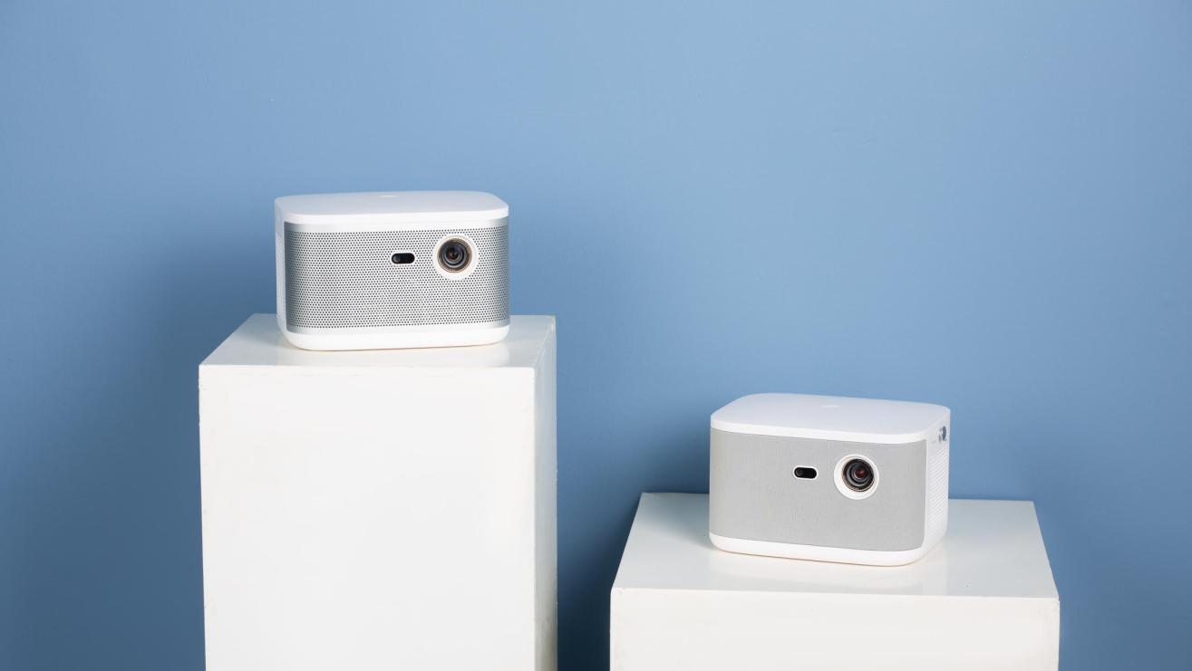

Slide 12
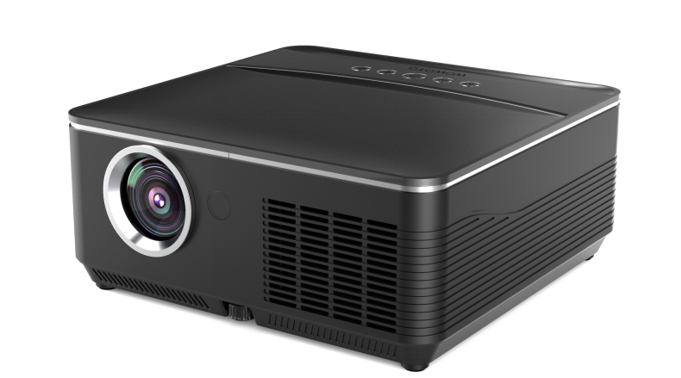
ES-P44
1000 ANSI
Support 3D
Electric focus
Four way trapezoidal correction

Slide 13
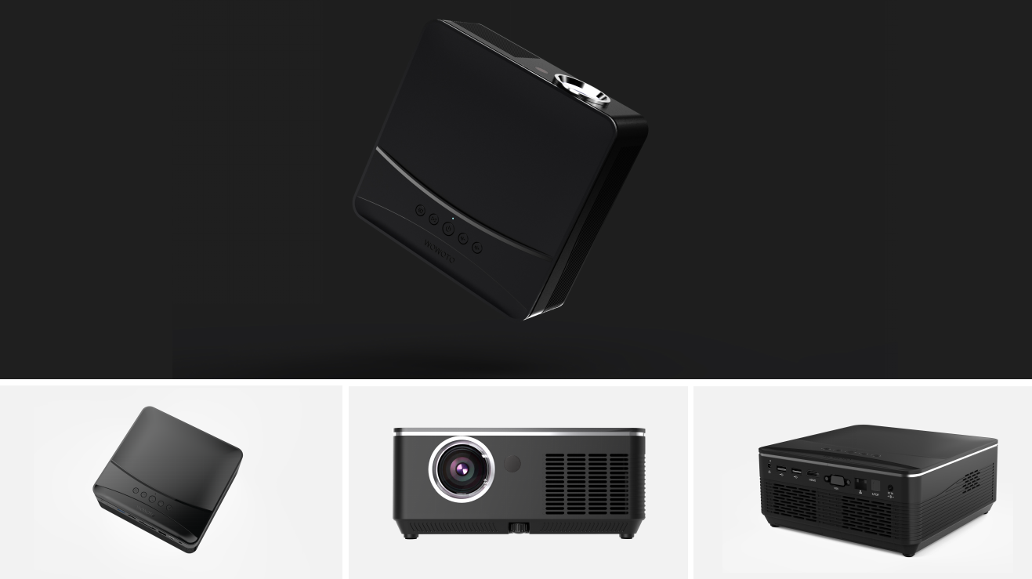

Slide 14
Product Parameters
Projector Type
Model
Projection Technogy
Light Source
Colour
Dimension
Brightness
Native Resolution
Light Life
Projection Ratio
Projection Distance
Aspect ratio
Focus Mode
Keystone Correction
System memory
Rom
WLAN
Bluetooth
Power
Product weigh
Android Desktop
ES-P44
DLP
LED
Black
188*182*81mm
1000ANSI
1280x800
>20000hours
1.2:1
20-150 inch
16:9
Auto
Four way+automatic vertical
2GB
16GB
802.11 a/b/g/n（2.4G+5G dual band）
BT4.0
19V 4.74A
1260g
81mm
188mm

